Slide 1

Machine learning technology for correcting electronic medical texts in Russian
Student: Dmitry Pogrebnoy, J42332c
Supervisor: Sergey Kovalchuk, PhD

Slide 2
Electronic medical records
Many medical models based on patients' medical records
Quality of models depends mainly on the quality of source texts
Patient data is a plain text with many spelling errors
Spelling errors greatly reduce the quality of the final models
Fixing such errors will improve the quality of the medical models
2/19

Slide 3

Goal and tasks
Goal: Design a method and implement an automatic spelling correction tool for medical texts in Russian.
Tasks:
Perform an overview of the Russian medical texts correction.
Analyze existing solutions for correcting Russian texts.
Design a new method for correcting spelling errors.
Design the architecture and implement a new spelling correction tool.
Conduct approbation of the developed tool.
Compare results of the developed tool and existing ones.
3/19

Slide 4
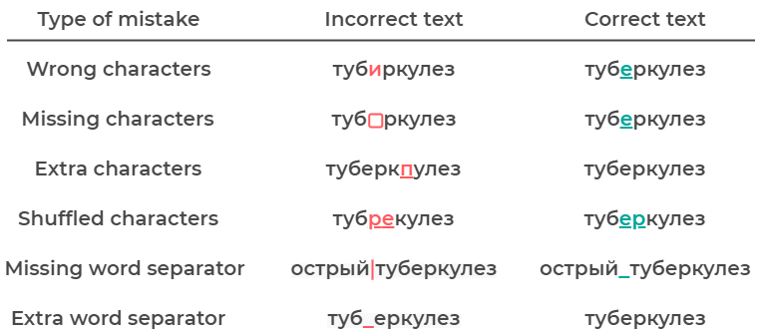
Spelling errors
4/19

Slide 5
Existing tools
There are several Russian open source tools
Aspell
Hunspell
Enchant
LanguageTool
Symspell
Jumspell
Not one is intended for medical texts
Not one uses advanced language models
5/19

Slide 6
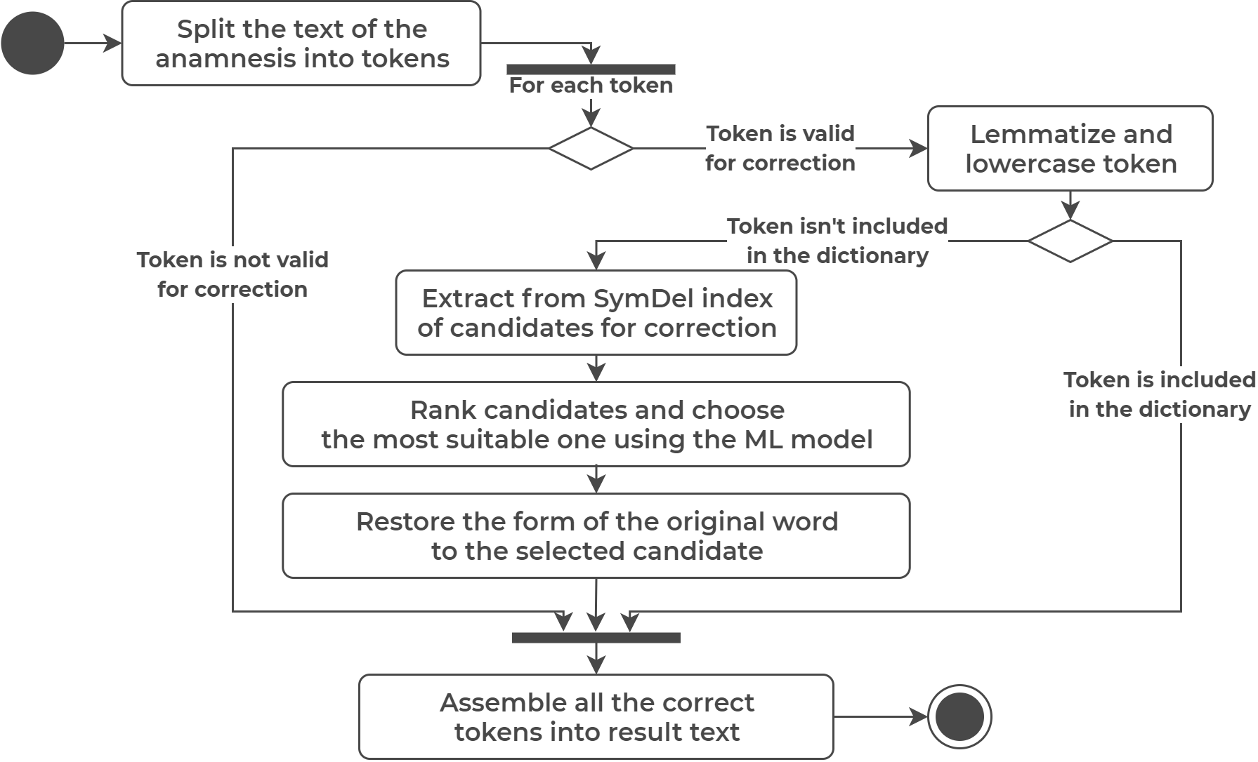
Spelling correction process
6/19

Slide 7
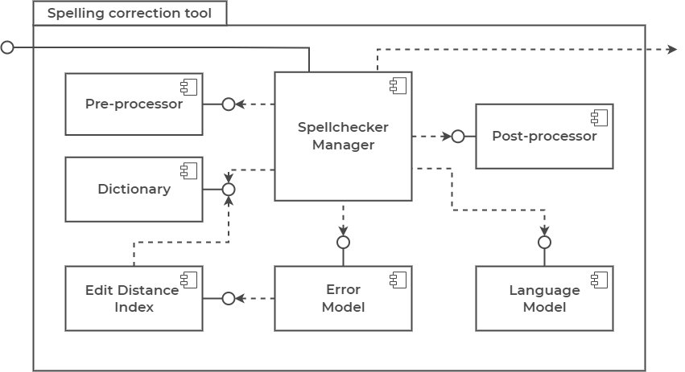
Tool architecture
7/19

Slide 8
Anamneses dataset
Public datasets
RuMedNLI – 14716 records
RuMedPrimeData – 15249 records
Private datasets
Almazov National Medical Research Center – 2355 records
Research Institute of the Russian Academy of Sciences – 161 records
All datasets were pre-processed and assembled into final one
Tokenization and lemmatization
Stop words filtering
8/19

Slide 9
Fine-tune BERT models
sberbank-ai/ruRoberta-large → MedRuRobertaLarge
Size – 1.4 Gb
distilbert-base-multilang-cased → MedDistilBertBaseRuCased
Converted from multilang to Russian model
Size - 217 Mb
cointegrated/rubert-tiny2 → MedRuBertTiny2
Size – 117 Mb
All models are published on the Hugging Face repository
RuBioBERT and RuBioBERTa were adapted for the tool
9/19

Slide 10
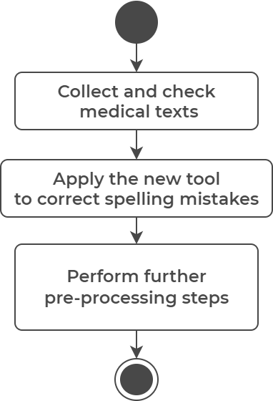
Method of tool use
Only for correction of medical texts in Russian
Preferably use for medical anamneses
Use in the preprocessing pipelines
Use before any other preprocessing steps
Make sure everything is okay afterwards
10/19

Slide 11
Example of correction
Tool | Corrected Result
Original | тревожное расстройство (золофт) и атопичекий дерматит
Aspell-python | тревожное расстройство золота и тапочкой дерматит
PyHunspell | тревожное расстройство золото аи топический дерматит
PyEnchant | тревожное расстройство золото аи атипический дерматит
LanguageTool-python | тревожное расстройство (золото) и утопический дерматит
PySpellChecker | тревожно расстройство (золофт) и атопичекий дерматит
SymspellPy | тревожное расстройство (золофт) и утопический гематит
Jumspell | тревожное расстройство (золофт) и атопичекий дерматит
Tool (MedDistilBERT) | тревожное расстройство ( золофт ) и атопический дерматит
11/19

Slide 12
Word tests internals
Single test - error and lexical precision
2700 test samples
Context test - error and lexical precision
2700 test samples
10 words in each sample
One of ten words is incorrect, other words are correct
Same incorrect words as in single test
Test on real anamnesis
100 real anamnesis from Almazov dataset
Count the correct and unnecessary corrections
12/19

Slide 13
Single word test
Tool | Error precision | Lexical precision | Average precision | Average words per second
Aspell-python | 0.86 | 0.859 | 0.859 | 283.7
PyHunspell | 0.812 | 0.539 | 0.675 | 9.4
PyEnchant | 0.829 | 0.541 | 0.685 | 20
LanguageTool-python | 0.762 | 0.904 | 0.833 | 25.1
PySpellChecker | 0.354 | 0.86 | 0.607 | 3.4
SymspellPy | 0.399 | 0.813 | 0.606 | 9702.8
Jumspell | 0.267 | 0.947 | 0.607 | 2552.1
Tool (CPU, MedDistilBERT) | 0.701 | 0.991 | 0.846 | 12.7
Tool (GPU, MedDistilBERT) |  |  |  | 39.7
13/19

Slide 14
Context word test
Tool | Error precision | Lexical precision | Average precision | Average words per second
Aspell-python | 0.739 | 0.93 | 0.835 | 357.3
PyHunspell | 0.706 | 0.719 | 0.713 | 11.8
PyEnchant | 0.721 | 0.719 | 0.72 | 24.3
LanguageTool-python | 0.727 | 0.942 | 0.835 | 43.6
PySpellChecker | 0.304 | 0.868 | 0.586 | 6.7
SymspellPy | 0.37 | 0.913 | 0.642 | 26060.2
Jumspell | 0.307 | 0.969 | 0.638 | 4322.3
Tool (CPU, MedDistilBERT) | 0.765 | 0.99 | 0.878 | 45.5
Tool (GPU, MedDistilBERT) |  |  |  | 153.8
14/19

Slide 15
Test on real anamnesis
Tool | Correct fixes | Unnecessary fixes | Fixes ratio
Aspell-python | 20 | 171 | 0.105
PyHunspell | − | − | −
PyEnchant | − | − | −
LanguageTool-python | 21 | 135 | 0.135
PySpellChecker | − | − | −
SymspellPy | − | − | −
Jumspell | − | − | −
Tool (MedRoBERTa) | 19 | 6 | 0.76
Tool (MedDistilBERT) | 18 | 9 | 0.667
Tool (MedBertTiny2) | 17 | 11 | 0.607
15/19

Slide 16
Python package
Assembled the pip python package
Package contains
Source code
Dictionary with correct words
No models included
Models are loaded dynamically as needed
Published package name – medspellchecker
16/19

Slide 17
Conclusion
Overview of the Russian medical texts correction is performed.
Existing solutions for correction of Russian texts are analyzed.
The new method of correcting spelling errors in Russian medical texts is designed.
The new spelling correction tool is designed and implemented.
The approbation of the developed tool is conducted.
Results of the developed tool and existing ones are compared.
17/19

Slide 18
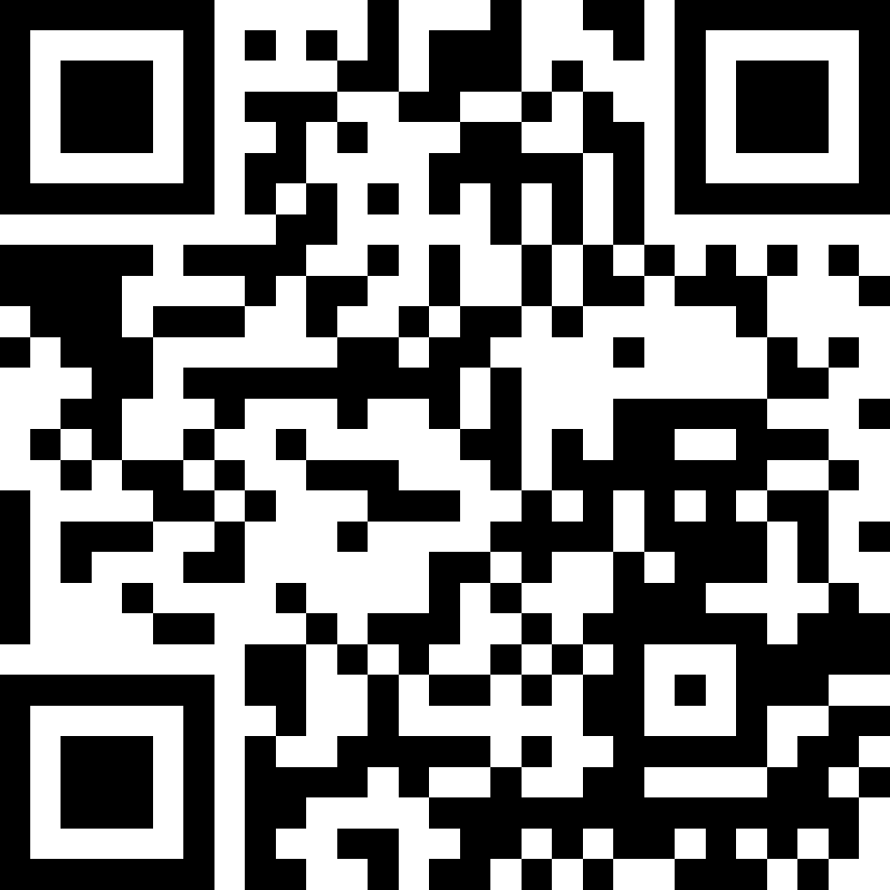
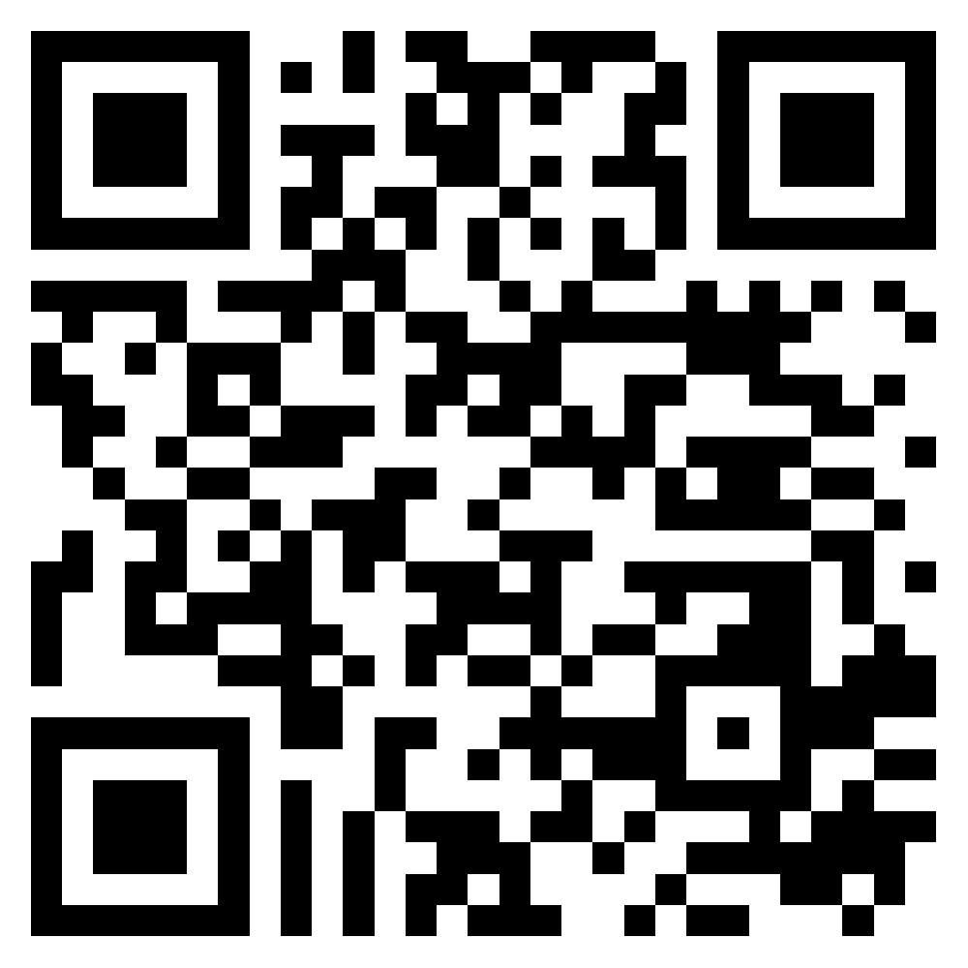
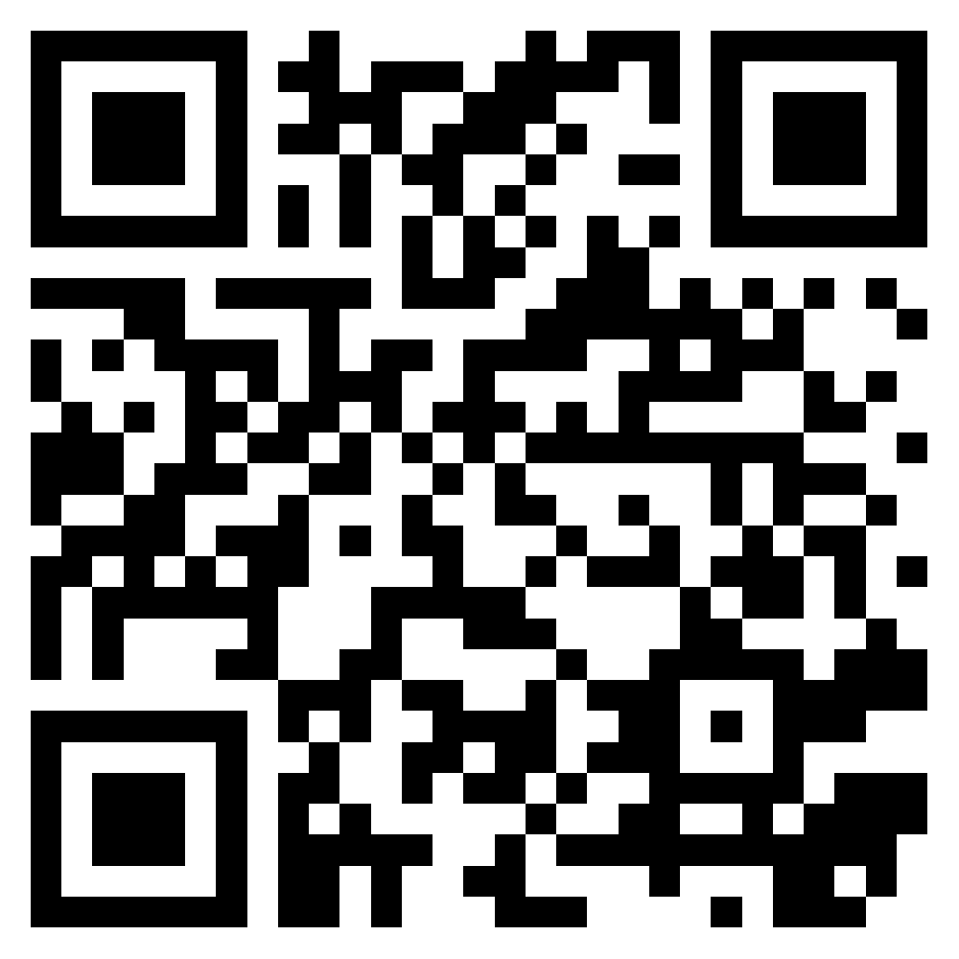
Links
GitHub project
github.com/DmitryPogrebnoy/MedSpellChecker
Fine-tuned models
huggingface.co/DmitryPogrebnoy
Pip package
pypi.org/project/medspellchecker
18/19

Slide 19

Thank you for your attention!

Slide 20
Metrics
Error precision – the ratio of the number of correctly corrected words to the total number of incorrect words
Lexical precision – the ratio of the number of unchanged modified words to the total number of correct words
Average precision – the average of error precision and lexical precision
Performance – the number of words processed by the tool per second
Correct fixes - the number of correctly fixed errors
Unnecessary fixes - the number of correct words corrected
Fixes ratio - the ratio of the correct fixes metric to the unnecessary fixes
20/19

